Slide 1
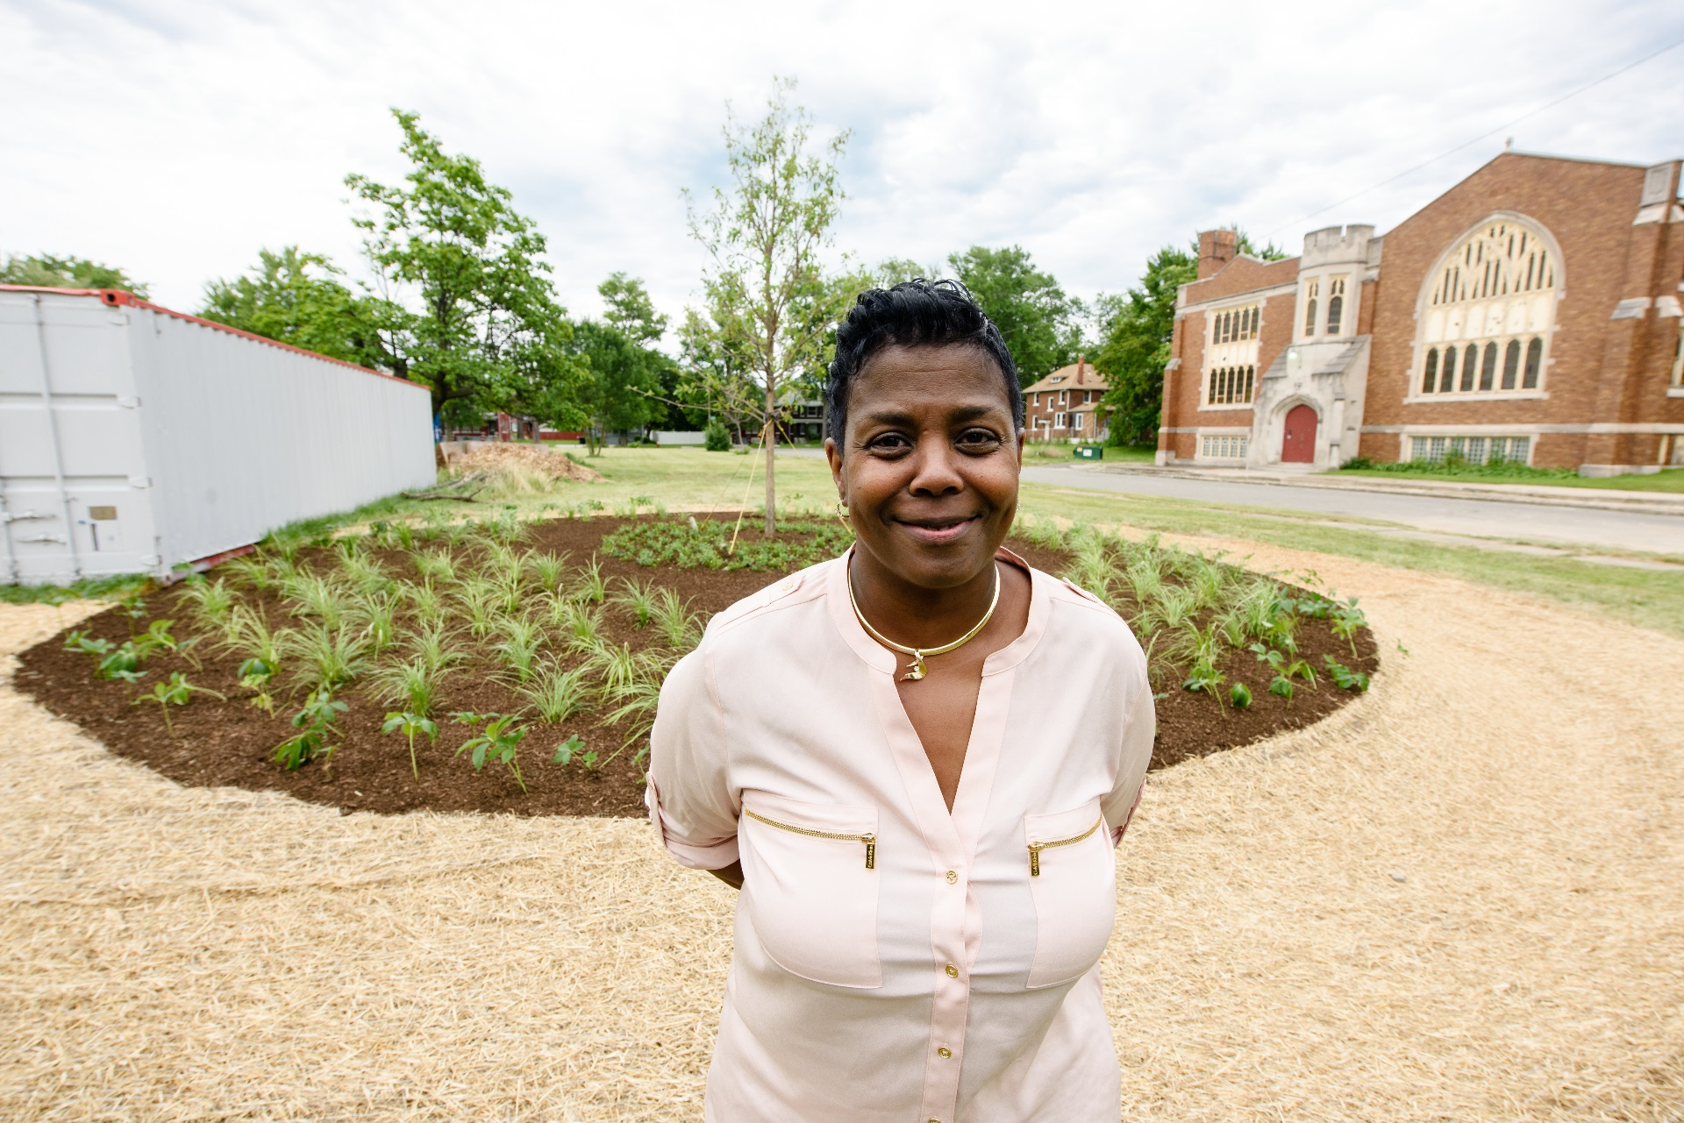
Notes:
The Land + Water Works! Campaign is led by Detroit Future City.
We began discussing the effort in the hopes of creating a green culture shift initiative to motivate Detroit businesses and residents to embrace the idea of being land and water stewards.
We hope through education and installation of green stormwater infrastructure, and learning together that we will help one another transition to the new way of thinking about our land and water resources.
The city of Detroit’s Water and Sewerage Department’s roll out of their updated drainage fee charges policy that includes “green” credits, we envision an opportunity to improve our water, land and air quality.
Resident’s will roll over to the new way of calculating the fee in July 2018.

Slide 2
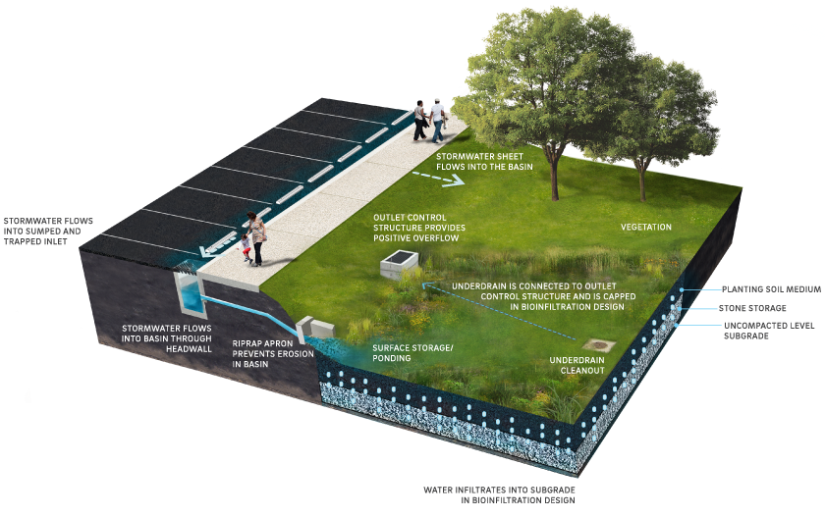
1
7
4
5
6
Image Source: www.pwdplanreview.org
2
3
Image Source: www.pwdplanreview.org
Notes:
This is more technical. It’s probably overkill, but this let’s the group have a more informed understanding.
You can go into detail, or just show this image to illustrate the many steps in engineered bioretention.
Primary Components of a Bioretention System
1. Pretreatment (a structure that helps reduce clogging)
2. Flow inlet
3. Ponding area
4. Plant material
5. Organic layer or mulch *
6. Planting soil/volume storage bed
7. Positive overflow

Slide 3
GSI Practices: Bioretention
Bioretention treatments are shallow surface depressions planted with vegetation to capture and treat stormwater runoff
Can be simple or engineered to manage many gallons of stormwater

Slide 4
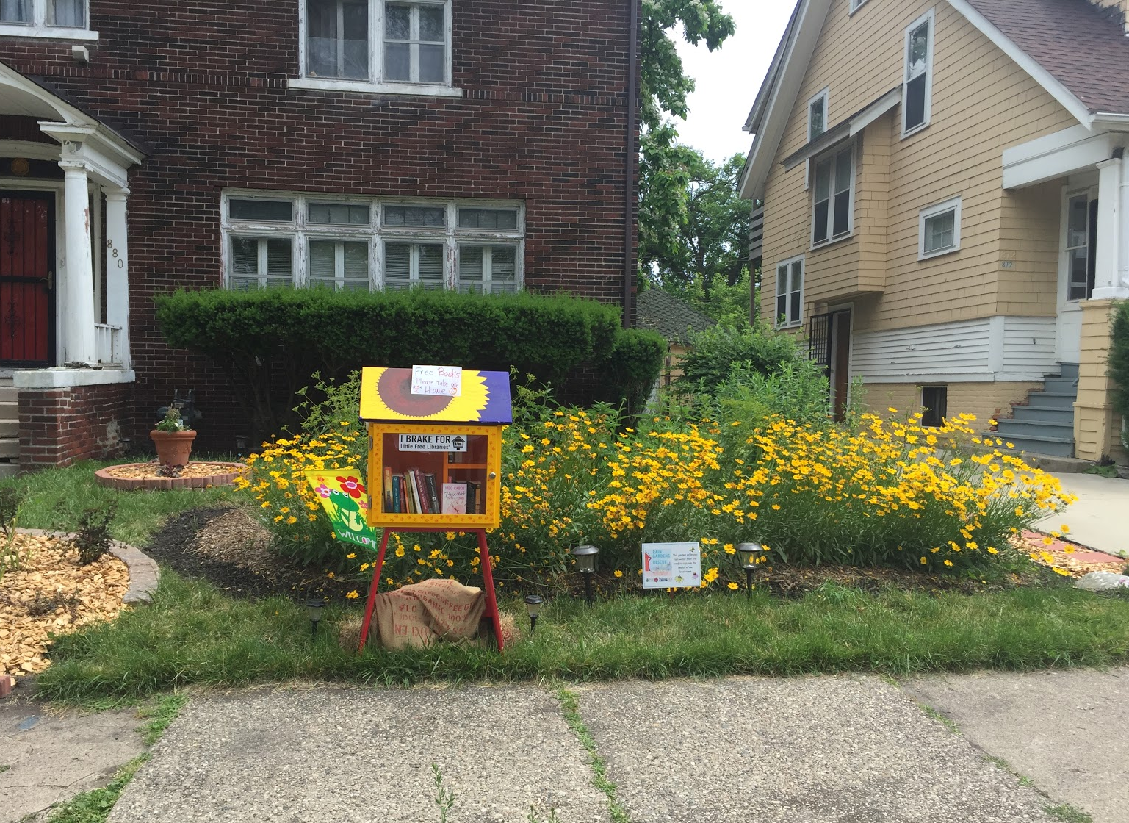
Notes:
A rain garden collects stormwater from rooftops and pavement. They have are designed to sit below ground with a flat base, to slowly soak in stormwater. Rain gardens come in many shapes and sizes, and are good treatments for properties with space.

Slide 5
GSI Practices: Rain Garden
Collects runoff from roof tops and pavement
The flat base of the garden is designed to sit just below ground, and filled with good soil
Simple and effective, can be built by residents
Improves water quality
Can serve as community recreation spaces improving health and social neighborhood conditions
Helps to return native wildlife to the area in the forms of birds and pollinators
Notes:
A rain garden collects stormwater from rooftops and pavement. They have are designed to sit below ground with a flat base, to slowly soak in stormwater. Rain gardens come in many shapes and sizes, and are good treatments for properties with space.

Slide 6
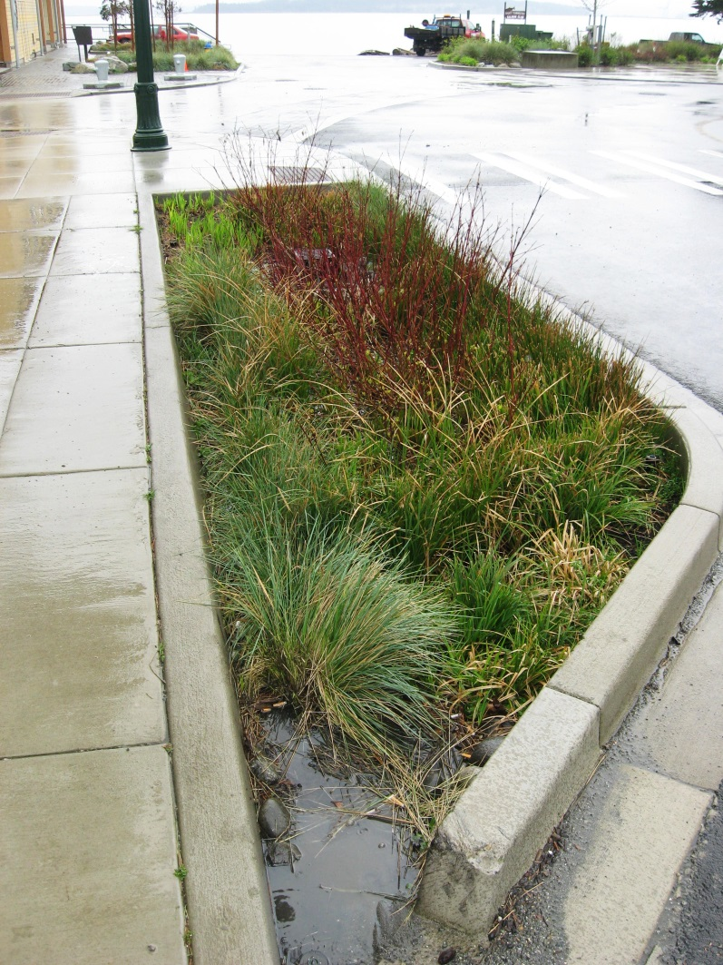
http://integritylandworks.com/can-you-have-a-rain-garden-without-rain
Notes:
A swale is another word for a ditch. You can think of “Bio” as the plants.
Most highways will include a simple swale, for example I-696. Neighborhoods near Tireman on the west side have these as well, which were converted in bioswales.
Similar to raingardens, these systems typically collect water off large surface areas, including streets.

Slide 7
GSI Practices: Bioswale
Collects runoff from larger surface areas, including streets and parking lots.
Designed for narrow spaces.
Used to move and infiltrate water
Improves water quality
Reduces noise pollution
Improves air quality by absorbing noxious substances like sulfur dioxide and particulate matter
http://integritylandworks.com/can-you-have-a-rain-garden-without-rain
Notes:
A swale is another word for a ditch. You can think of “Bio” as the plants.
Most highways will include a simple swale, for example I-696. Neighborhoods near Tireman on the west side have these as well, which were converted in bioswales.
Similar to raingardens, these systems typically collect water off large surface areas, including streets.

Slide 8
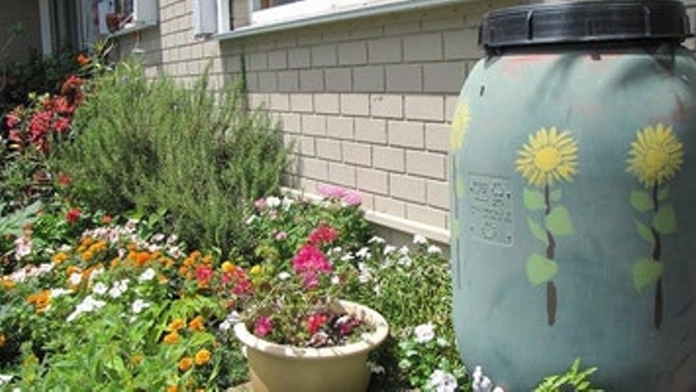
Image Source: LID Manual for Michigan, 2008; Sierra Club
Notes:
Residential rain barrels are becoming common (Thanks Raingardens to the Rescue!)

Slide 9
GSI Practices: Rain Barrels
Above ground designs can blend into the landscape
Water can be pumped
Residential rain barrels are becoming common
Larger commercial options available
50 - 50,000 gallons
Plastic, Metal
No vegetation, but can be designed to over flow into a rain garden.
Improves water quality
Captured stormwater can be used for outdoor irrigation and some in home uses
Image Source: LID Manual for Michigan, 2008; Sierra Club
Notes:
Residential rain barrels are becoming common (Thanks Raingardens to the Rescue!)

Slide 10
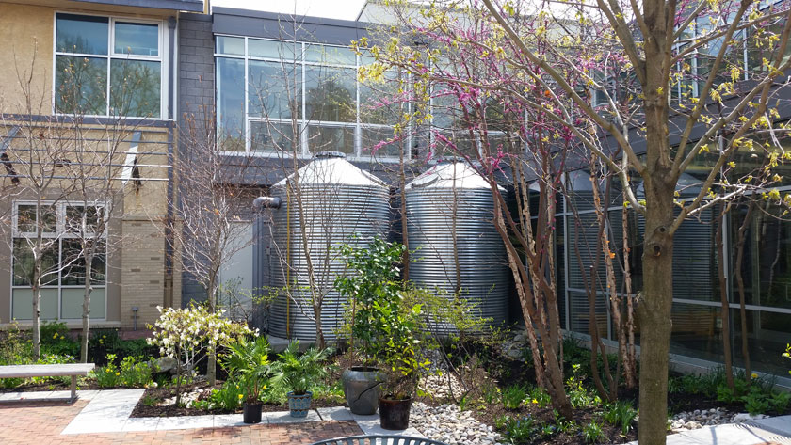
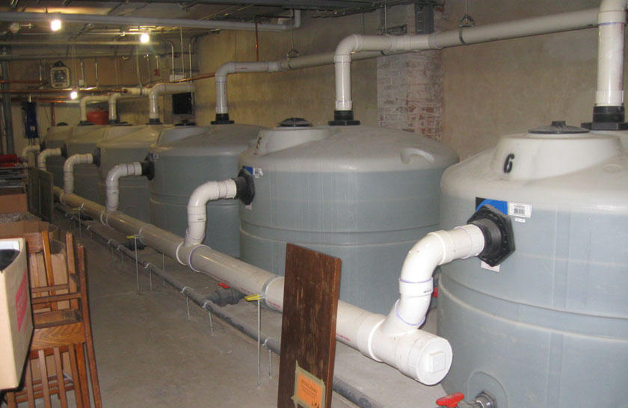
Image Source: LID Manual for Michigan, 2008

Slide 11
GSI Practices: Cisterns
Above ground designs can blend into the landscape
Sub-surface designs do not take up valuable space. Often located in building basements for easy access and maintenance
Water can be pumped and reused for beneficial purposes
Plastic, Metal, Concrete
Improves water quality
Captured stormwater can be used for outdoor irrigation and some in home uses
Image Source: LID Manual for Michigan, 2008

Slide 12
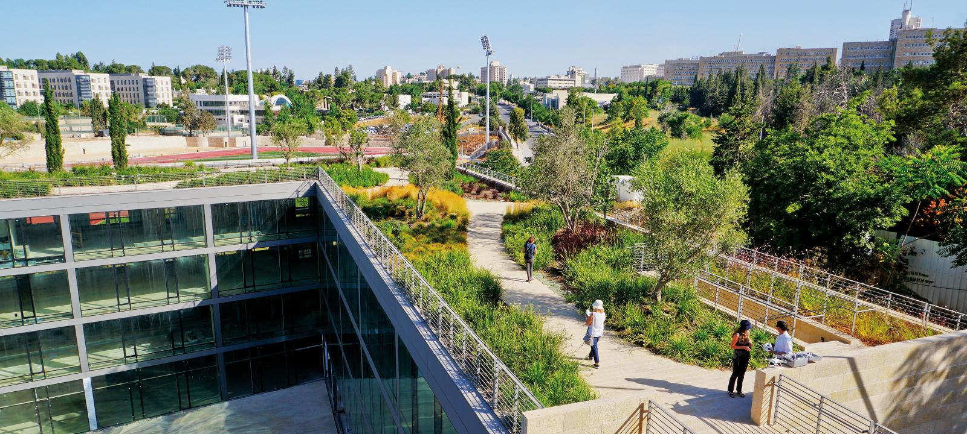
Image Source: www.pwdplanreview.org

Slide 13
GSI Practices: Green Roofs
A roof system that uses plants to provide environmental benefits, including managing stormwater.
Can be installed as a new construction or retro-fit GSI solution
Retro-fit green roofs can add substantial cost due to the need for additional expertise - roofing expertise and structural engineer
Improves air quality by absorbing noxious substances like sulfur dioxide and particulate matter
Increases property values
Reduces urban heat island effect
Brings native birds and pollinators which are important to food production back to the area
Image Source: www.pwdplanreview.org

Slide 14
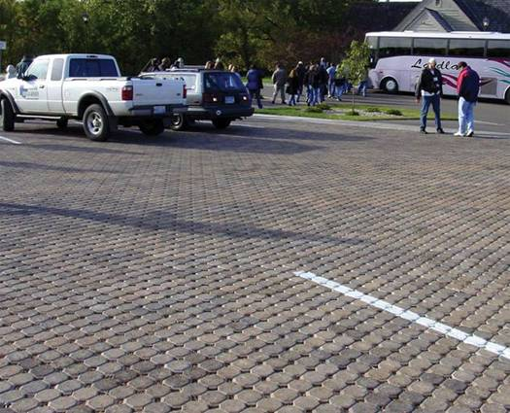
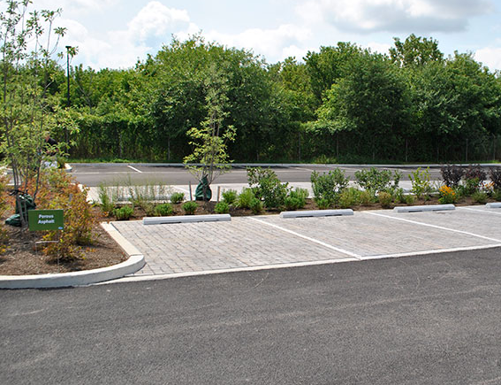
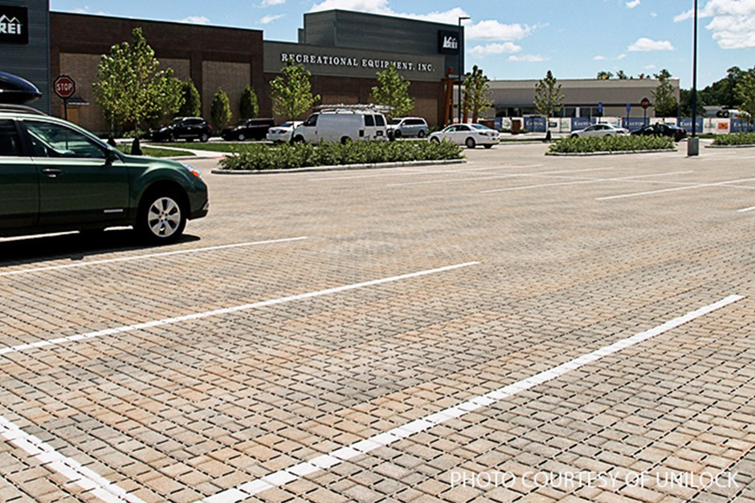
Notes:
Top Image: Multiple GSI treatments applied to parking lot. (FYI, budget wise, it seems overkill to do permeable asphalt, pavers AND a bioswale all in one area. Likely, this parking lot would choose regular asphalt and permeable paver).
Bottom Image: Pervious Concrete looks different than impervious
Pervious asphalt looks the same as impervious

Slide 15
GSI Practices: Permeable Pavements
Type of pavement with high porosity that allows rainwater to pass through into the ground below
Permeable pavement can help clean and water by trapping pollutants
Suitable for large surfaces, parking lots, plazas, low-traffic roads
Types: Permeable Pavers, Permeable Concrete, Permeable Asphalt
Increases property values
Improves water quality
Notes:
Top Image: Multiple GSI treatments applied to parking lot. (FYI, budget wise, it seems overkill to do permeable asphalt, pavers AND a bioswale all in one area. Likely, this parking lot would choose regular asphalt and permeable paver).
Bottom Image: Pervious Concrete looks different than impervious
Pervious asphalt looks the same as impervious

Slide 16
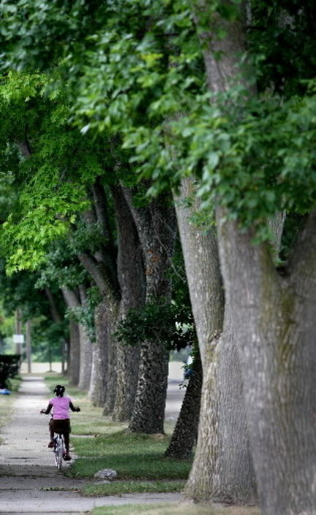
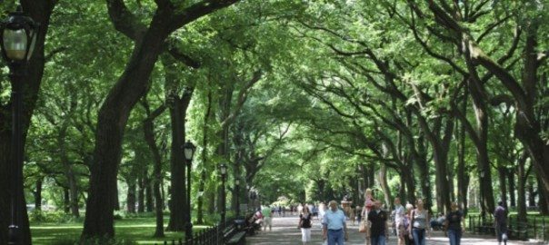
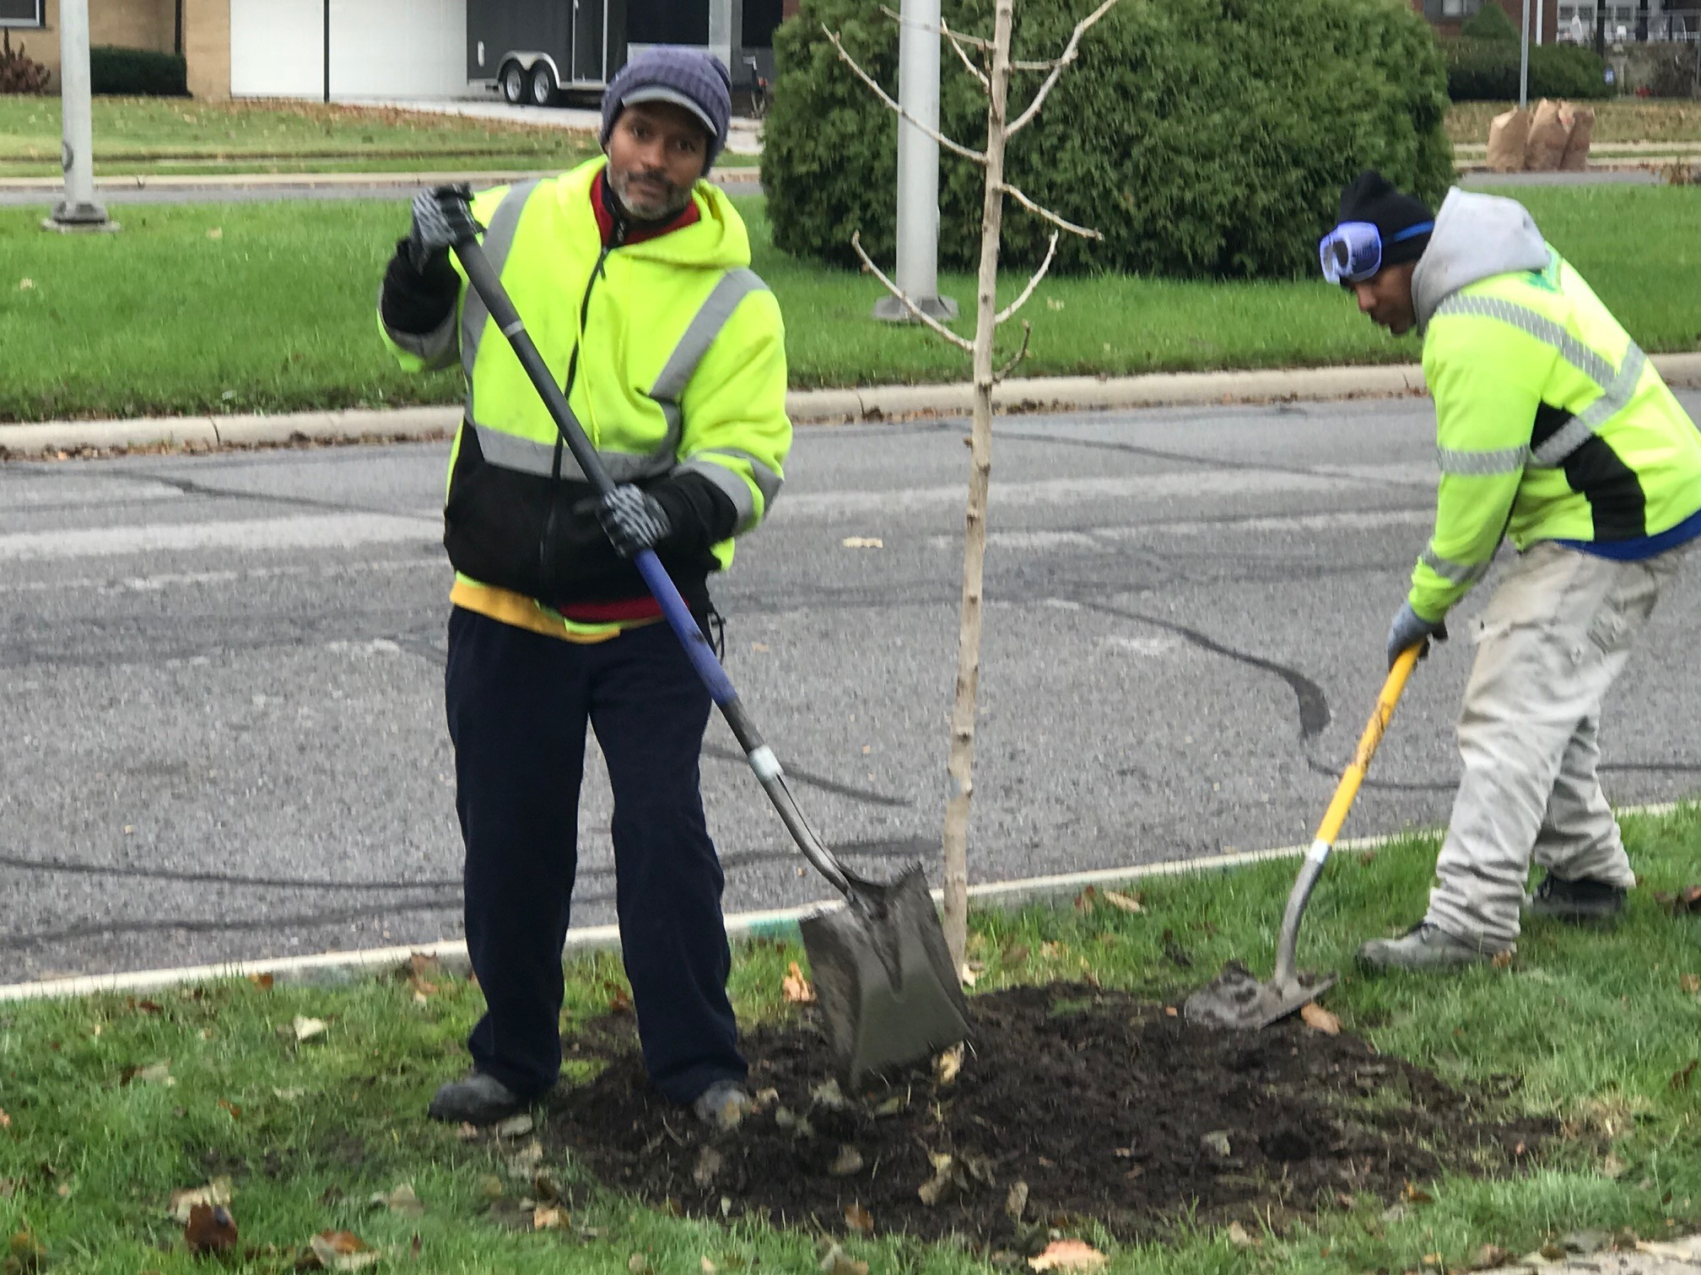

Slide 17
GSI Practices: Trees
Mature trees provide significant stormwater quantity and rate control benefits through soil storage and evapotranspiration
Reduces urban heat island effect
Improves air quality
Reduces energy usage
Increases tree canopy and tree species diversity
Increases property values
Improves water quality
Brings native birds and pollinators which are important to food production
back to the area
Notes:
Top Image: Multiple GSI treatments applied to parking lot. (FYI, budget wise, it seems overkill to do permeable asphalt, pavers AND a bioswale all in one area. Likely, this parking lot would choose regular asphalt and permeable paver).
Bottom Image: Pervious Concrete looks different than impervious
Pervious asphalt looks the same as impervious

Slide 18
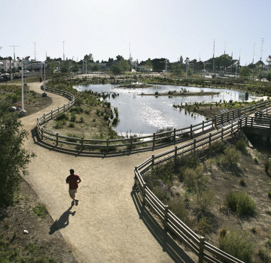
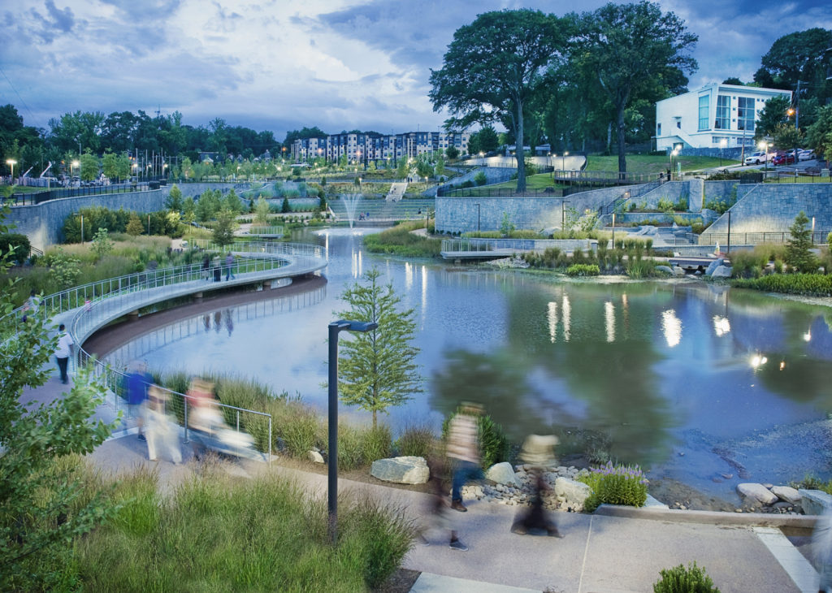
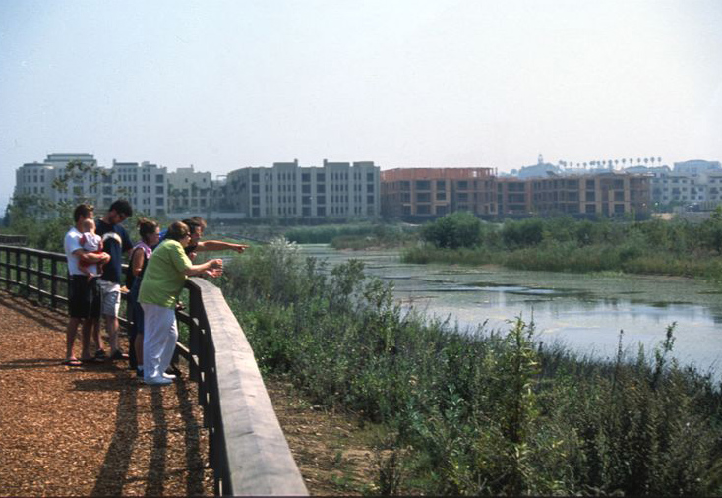

Slide 19
GSI Practices: Wetlands
Constructed wetlands may be build expressly for capturing and filtering stormwater or wastewater treatment. Plant can be chosen for performance, so constructed wetlands often do not contain the breadth of vegetation found in natural or restored wetlands, or provide all of their ecological services.
Built within a watershed wetlands temporarily store and filter stormwater during storm events.
Improves air quality
Improves water quality
Brings native birds and pollinators which are important to food production
back to the area
Notes:
Top Image: Multiple GSI treatments applied to parking lot. (FYI, budget wise, it seems overkill to do permeable asphalt, pavers AND a Bioswale all in one area. Likely, this parking lot would choose regular asphalt and permeable paver).
Bottom Image: Pervious Concrete looks different than impervious
Pervious asphalt looks the same as impervious

Slide 20
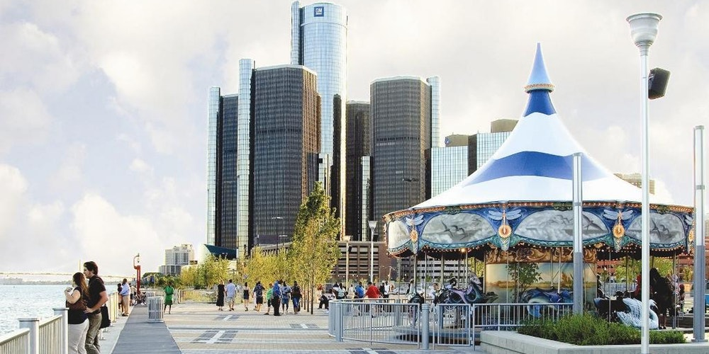
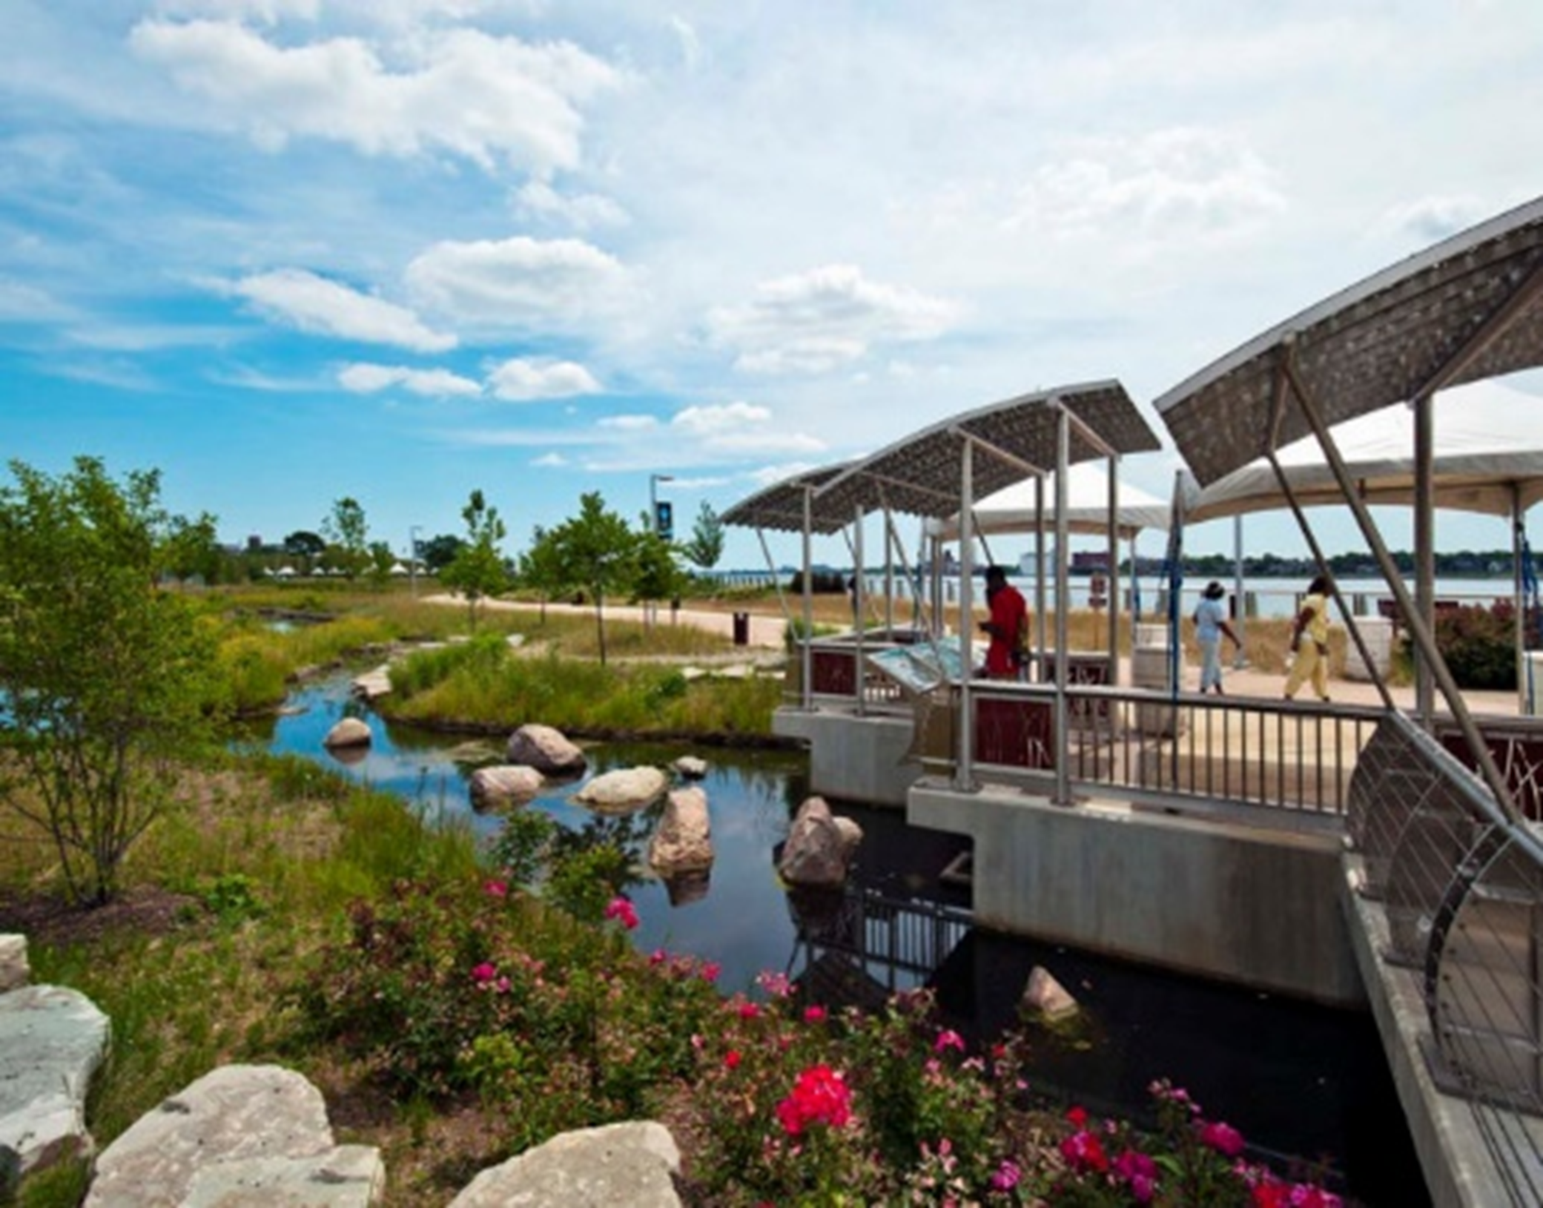
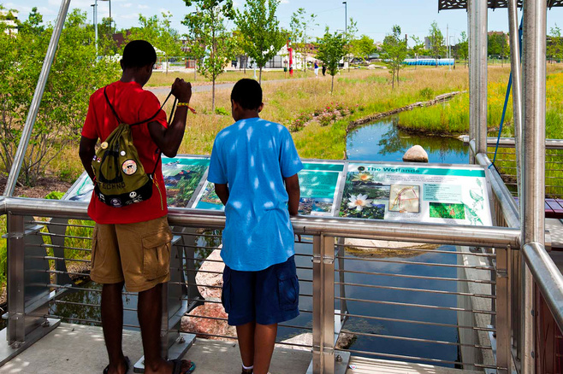
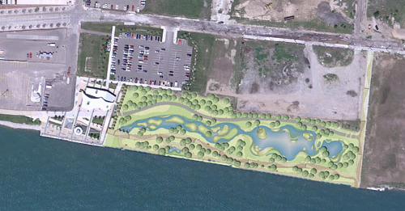
Local Examples: Milliken State Park
Notes:
Who here has spent time on the River Walk? Do you recognize this scene?
Encourage 1-2 people to share the last time they were there and what they were doing.

Slide 21
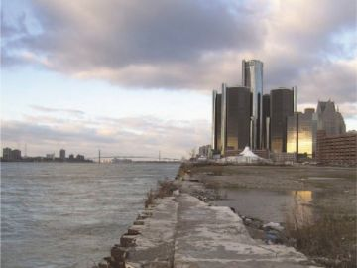
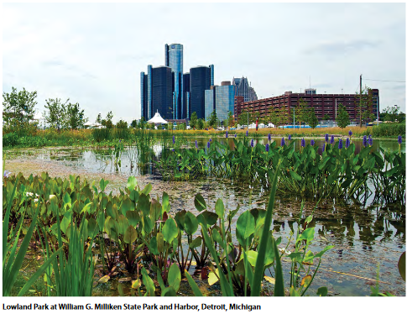
Local Examples: Milliken State Park
BEFORE
AFTER
Image Source: http://https://landscapeperformance.org/case-study-briefs/milliken-state-park-lowland-park/
Notes:
Top Image After the construction of [___] gal wetland,
Created native habitat for 62 species of migratory and resident birds, reptiles and amphibians.
Bottom Image Before construction of Milliken State Park and the constructed wetland, the former industrial site was unfriendly and uninhabitable.

Slide 22
Local Examples: Milliken State Park
Contains GSI elements of an wetlands and permeable pavement
The only wetland community within Detroit's urban core
Created native habitat for 62 species of migratory and resident birds, reptiles and amphibians.
Contains native plantings and trees
Construction began in 2004 and was completed in 2009
Image Source: http://www.onlyinyourstate.com/michigan/detroit/underappreciated-parks-detroit/
Notes:
When you were at the River Walk, did you visit the stream, near that last location? That stream is a constructed wetland originally designed to manage millions of gallons of water from over 12 acres of land.
Not only does it slow the water down, it removes a number of pollutants, before depositing into the Detroit River.
It also provides habitat for 62 species of migratory and resident birds, reptiles and amphibians, which is really important because the Detroit River has lost 97% of its original wetlands due to human development.
(In fact, the last mile of natural shoreline, Humbug Marsh, was saved and protected by thousands of residents, government agencies and nonprofits working together.)

Slide 23
Q & A

